Slide 1

Product Analytics Dashboard
A Data-Driven Approach to Understanding Product Performance
A Power BI Dashboard for Product Analytics.
NAME: SRIKANTH MATCHA
Tools Used: Excel, Microsoft SQL Server, Power BI

Slide 2
Request From Management
Dashboard Requirement: Product Analytics Overview
Management Request Summary:
We need a high-level Product Analytics Dashboard that provides insights into key product
performance metrics and supports strategic decision-making.
Dashboard Requirements:
Revenue by Country
  Identify top-performing countries by revenue.
Revenue by Date and Year
  Show monthly and yearly revenue trends.
Revenue Breakdown by Discount Band
  How revenue is distributed across discount categories.
Detailed Table View
  Revenue and profit breakdown by country and year.

Slide 3
Project Workflow
1. Build the Database
• Imported raw Excel data into SQL Server and structured it for analysis.
2. Write SQL Queries
• Cleaned, transformed, and prepared the data using SQL.
3. Connect to Power BI
• Loaded SQL data into Power BI for modeling.
4. Create the Dashboard
• Built reports, visualizations, KPIs, and insights.

Slide 4
Asces Company Profile
Asces Sound — Company Overview
A leading innovator in the audio technology industry, delivering high-quality audio solutions for professionals and enthusiasts.
Known for exceptional sound clarity, advanced engineering, and user-friendly designs.
Trusted by musicians, content creators, and audio engineers worldwide.
Specializes in audio interfaces, microphones, and accessories built with cutting-edge technology and durability.
Recognized for flagship products that enhance creative workflows and deliver superior sound performance.
Driven by a passion for innovation, we empower customers with tools that inspire creativity and redefine audio possibilities.

Slide 5
Data Sources Used in the Project
1️⃣ Discount Data (Excel File)
Month
Discount Band
Discount
2️⃣ Product Data (Excel File)
Product ID
Product Name
Category
Cost Price
Sale Price
Brand
Description
Image URL
3️⃣ Sales Data (Excel File)
Date
Customer Type
Country
Product
Discount Band
Units Sold

Slide 6
Importing Data into SQL Server
📌 Import Process
All three Excel files (Discount Data, Product Data, Sales Data) were imported into SQL Server Management Studio (SSMS).
Tables were cleaned and structured properly to ensure smooth analysis.
📂 Tables Loaded Into SQL Server
Discount Table
Product Table
Product Sales Table

Slide 7
SQL Query Used for Data Preparation
with cte as (
select a.Product,
a.Category,
a.Brand,
a.Description,
a.Sale_Price,
a.Cost_Price,
a.Image_url,
b.Date,
b.Customer_Type,
b.Discount_Band,
b.Units_Sold,
(Sale_Price*Units_Sold)as revenue,
(Cost_Price*Units_Sold)as Total_Cost,
format(date,'MMMM')as month,
format(date,'yyyy')as Year
from Product_data as a
join product_sales as b on a.Product_ID=b.Product)
select*
,(1-Discount*1.0/100)*revenue as Discount_revenue
from cte a
join discount_data b on a.Discount_Band=b.Discount_Band and a.month=b.Month

Slide 8
Importing SQL Data into Power BI
Importing SQL Data into Power BI
After writing and validating the SQL query in SQL Server Management Studio (SSMS), I connected Power BI to SQL Server.
I used Get Data → SQL Server option in Power BI.
I pasted my SQL query inside the Advanced Options → SQL Statement input box.
Power BI executed the SQL query and converted the results into tables.
These tables were then loaded into Power BI for further data cleaning, modeling, and visualization.

Slide 9
Data Cleaning & Transformation in Power BI
Data Cleaning & Transformations (Power Query)
After loading the SQL query output into Power BI, I opened Power Query Editor.
Performed essential data cleaning steps such as:
  Removing unnecessary columns
  Fixing data types (Date, Text, Whole Number, Decimal)
  Renaming columns for clarity
  Handling missing or null values
  Creating calculated columns if needed
Ensured all three tables (Sales, Products, Discounts) were clean and ready for modeling.

Slide 10
Building the Dashboard in Power BI
Dashboard Development in Power BI
After importing and transforming the SQL data into Power BI, I started the process of building the dashboard.
In this step, I performed the following tasks:
Created Visualizations for Key Insights
Used bar charts to show revenue by country
Used column charts to show monthly and yearly revenue patterns
Added a donut chart for discount band breakdown
Added a table visual to show customer type, revenue, and profit comparison
Added product images and descriptions using the Image URL and text fields
Designed the Layout
Arranged visuals in a clean and readable format
Added product gallery at the top
Highlighted key product details (image + description)
Applied Formatting
Used consistent color theme
Adjusted fonts, borders, and background colors
Ensured the dashboard is visually appealing and easy to understand

Slide 11
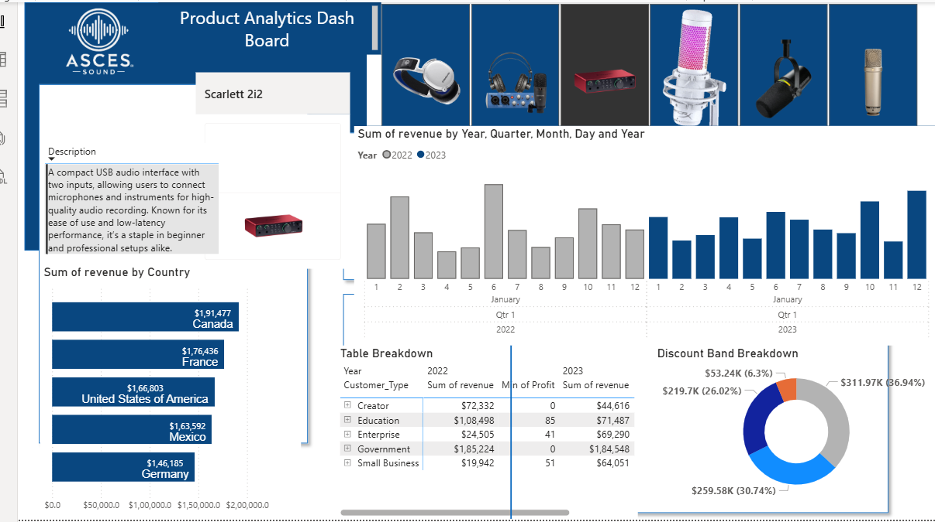
Final Dashboard Output
The final dashboard was created in Power BI, combining data from SQL Server and Excel sources.
The dashboard provides an interactive and visual summary of:
Product performance
Country-wise revenue
Monthly & yearly trends
Discount band breakdown
Customer type analysis
Product gallery with descriptions
This dashboard helps in understanding key business insights and supports decision-making for sales, pricing, and product strategy.

Slide 12
Key Insights from the Dashboard
1️⃣ Country-wise Revenue
Canada generated the highest revenue, followed by France, the United States, Mexico, and Germany.
This indicates strong product demand in North American and European markets.
2️⃣ Monthly & Yearly Trends
Revenue shows consistent growth from 2022 to 2023.
Certain months show noticeable peaks, indicating seasonal demand patterns.
3️⃣ Discount Band Breakdown
The largest portion of revenue comes from the Medium and High discount bands.
Customers respond well to strategic discounting, boosting sales volume.
4️⃣ Customer Type Performance
Top-performing customer segments include Creator, Education, and Enterprise.
These segments show strong purchasing behavior across both years.
5️⃣ Product-Level Insights
The dashboard highlights product descriptions, images, and pricing.
Users can explore product performance, profitability, and market positioning easily.

Slide 13
Conclusion & Final Summary
Project Summary
Successfully built a complete End-to-End Product Analytics Dashboard.
Data was sourced from Excel → SQL Server → Power BI.
SQL queries were used to clean, combine, and transform data before loading it into Power BI.
Dashboard provides rich insights into sales trends, revenue, discounts, and product performance.
What This Project Demonstrates
Strong skills in Excel, SQL, Power BI, Data Modeling, and DAX.
Ability to perform ETL (Extract, Transform, Load) using SQL and Power Query.
Capability to build interactive and professional dashboards.
Thank You Message
Thank you for reviewing my project!

